Slide 1
Artificial Intelligence in Advising

Slide 2
What Is Pathways Academic Advising
An intentional, collaborative, and ongoing partnership between the advisor and the student
This partnership involves proactive participation between the advisor and the student
Our goal in Advising is to assist students with completing their academic, career, and personal goals.
-Advising Syllabus, HCC Student Services

Slide 3
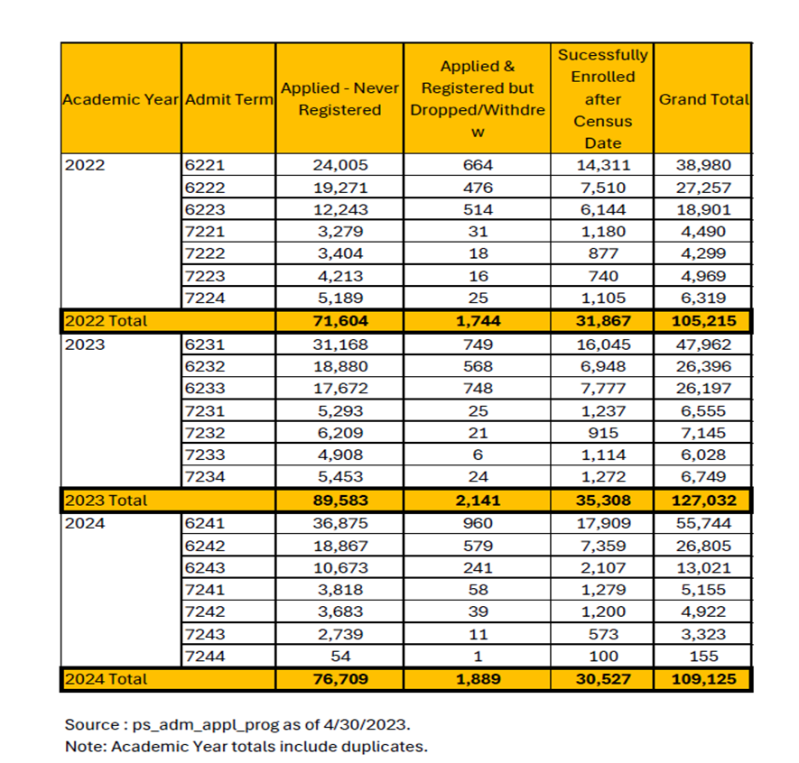
Challenge: Overview
If we make EVERY student come to an advisor for EVERYTHING, we bottleneck the access for students who actually need advising
However, both prospective and enrolled students face navigating vast amounts of information across HCC
Difficulty in finding accurate information leads to confusion and frustration, as well as wasted time for all involved

Slide 4
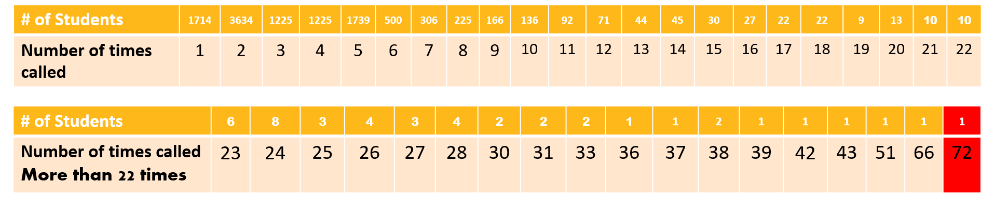
Wait Times
391 Students Waited More Than an Hour
12 Students Waited More than 2 Hours
Longest Student Waited 2:36:39
Powered by Compunetix

Slide 5
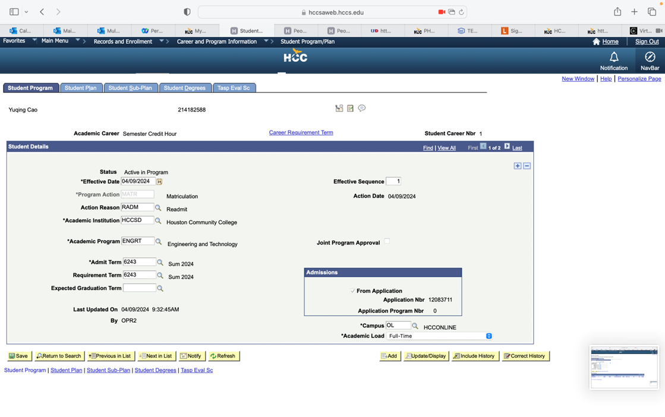
Challenge: Software
There are 27 panels on Peoplesoft to change or update program plans
Leads to lengthy meeting times, causing long wait times even for students who only need a few minutes

Slide 6
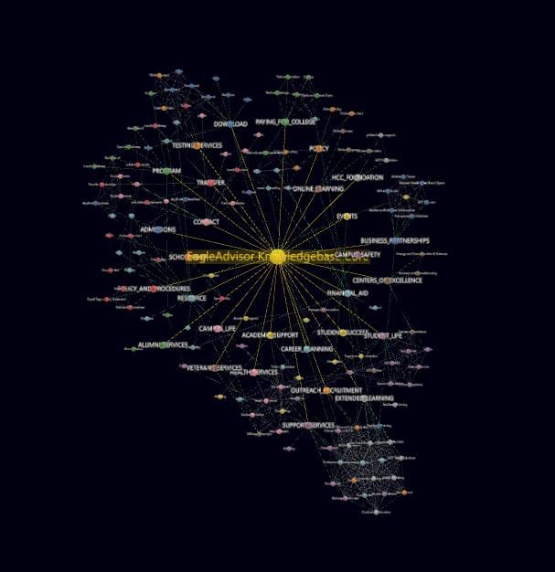
Solution: HCC AI Advisor
An intelligent chatbot designed to provide instant, accurate answers to general student questions
Understands and responds to questions using 80+ HCC hyperlinks and key documents
Can direct students and prospective students to appropriate resources

Slide 7
How it works:
Student asks a Question
AI Advisor Processes the Question
AI Advisor provides a clear answer
Students type or speak their questions in natural language.
**need something here**
Providing support whenever and wherever students need it

Slide 8
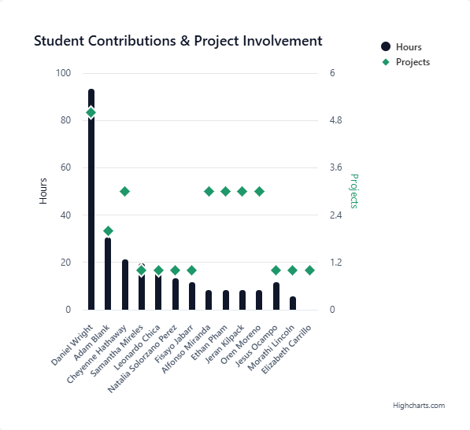
By Students, For Students
AI Students created the ChatBot, learning and building at the same time
Students can relate and apply their experience to be part of the solution
AI Faculty supervising the project, along with advising staff
https://hccai.ngrok.io/eagleadvisor_team_analytics

Slide 9

Enhanced Features for Enhanced Support
Voice-Enabled: Ask questions hands-free.
Multilingual Support: Catering to our diverse student body.
Multimodal Capabilities: Work with text, images, and audio to provide comprehensive answers.

Slide 10
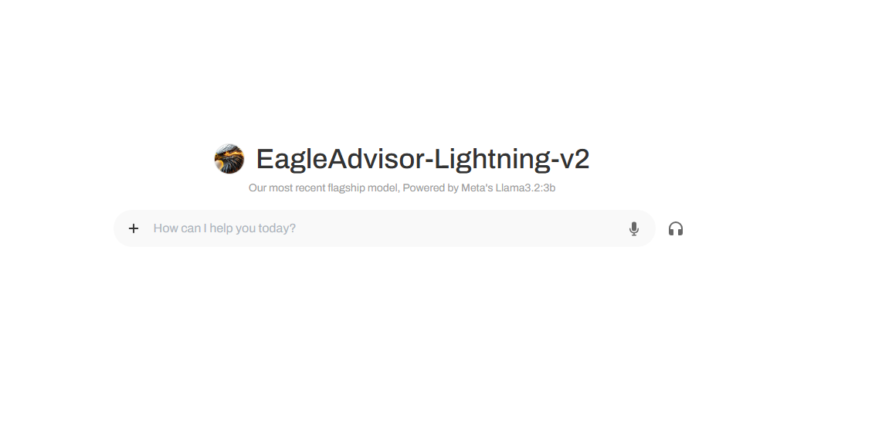
Let’s See Advisor AI in Action
https://hccai.ngrok.io/

Slide 11
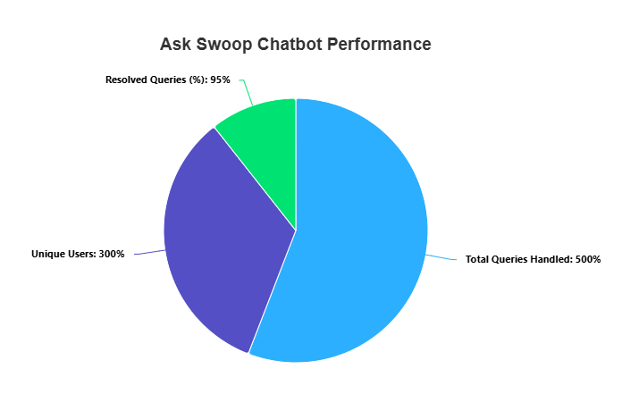
Benefits for HCC as a Whole
Efficiency and Cost Savings: Reduce staff workload and free up resources.
Data-Driven Insights: Analyze student inquiries to improve services and content.
More meaningful and impactful advising, leading to increased enrollment and retention
Communication: Streamline communication, ensuring students are connected to the right resources
Real World Education that involves students, drawing on their experiences to ensure an effective solution
https://hccai.ngrok.io/for-cheyenne#ask-swoop-performance

